Slide 1
Snake Nokia
DATE
Team : 12
Team member :
Vorng Viseth
Chhem Bunnak
Snake
Nokia
Subject : Algorithm & Computational Thinking I / Lecturer : Ronan the best

Slide 2
Snake Nokia
DATE
Table Of Contents
Introduction
Technical Demo
Team collaboration
Conclusion

Slide 3
Introduction
Snake Nokia
DATE
Why do we choose this project
Description of the project
the reason why we build this game is because we want to work on something that we can enjoy and have fun with, and make sure that it is not too hard for us .
This is a classic pixel snake game that let the user control the snake and makes their way through the grid while trying not to eat the wrong thing and let the player have the ability to customize their own snake
Project goals
Make a fun and interactive game
Implement a multiplayer function so we can enjoy it with our friend
Add more obstacles into the game than just wall collision
To help us understand more of 2D game, game loop, grid and array

Slide 4

Introduction > Key features
Snake Nokia
DATE
Choose color
The menu that let the player customize their own snake’s color to make the player feels interactive to the game
Bomb
One of the obstacles in the game that randomly spawn on the 2D grid between 10 - 29 seconds
Special food
Can be an obstacle or a help to your game based on your skill and usage
Game demo

Slide 5

Technical Demo > Data structure
Snake Nokia
DATE
Let’s move to Vscode
flow chart

Slide 6
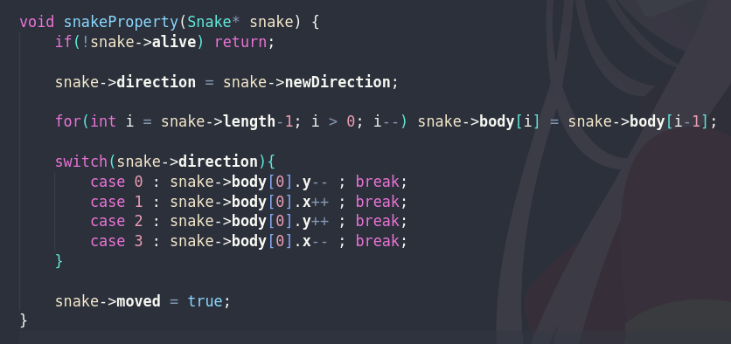
Technical Demo > code walkthrough
Snake Nokia
DATE
I
II
Snake Algorithm
1
3
1
3
2
2
III
IV
1
3
1
3
2
2

Slide 7
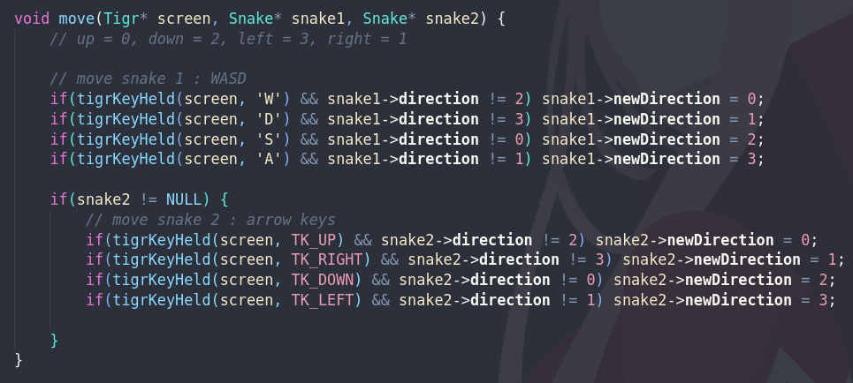
Technical Demo > code walkthrough
Snake Nokia
DATE
Snake Algorithm

Slide 8
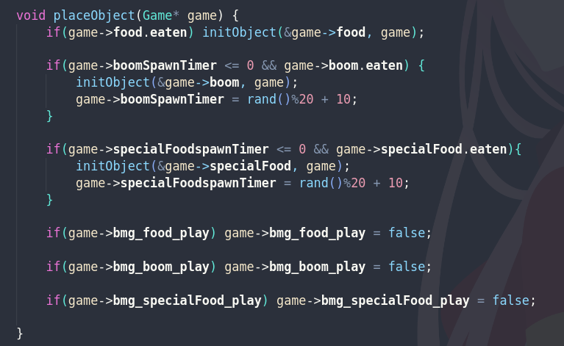
Technical Demo > code walkthrough
Snake Nokia
DATE
Food
Bomb
Object Algorithm
Special Food

Slide 9

Technical Demo > Data and Functions organization
Snake Nokia
DATE
Let’s move to Vscode
again!

Slide 10






Snake Nokia
DATE
Team collaboration
Chhem Bunnak
Vorng Viseth
Design game logic
Implement game mechanics (snake logic, object, collision, audio)
Implement Menu State
Testing & debugging
Implement Single Player State
Implement Multiplayer state
Implement Choose color State
Implement game mechanics(audio)
Testing & debugging

Slide 11
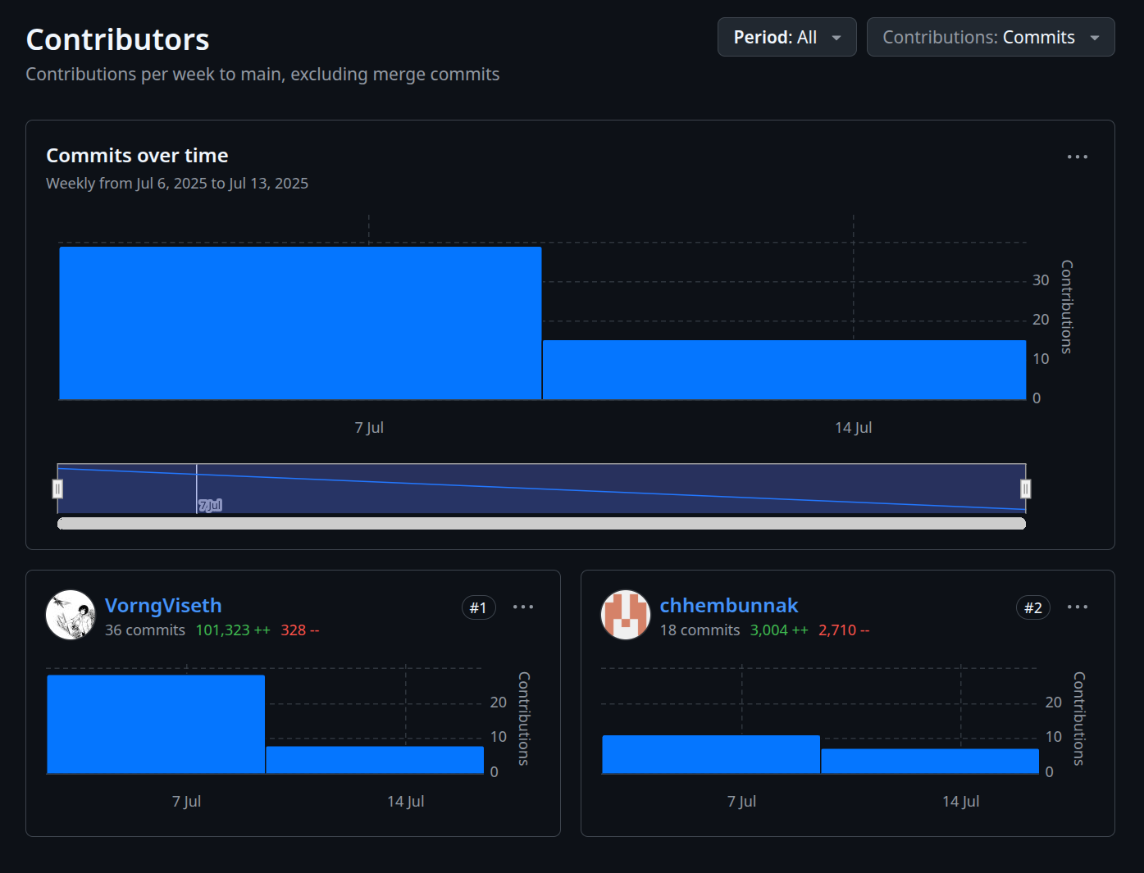
Snake Nokia
DATE
Team collaboration
Teamwork Statistic
Line of code : 730+ loc
Commit : 40+ commits
Code editor : Vscode
Collaboration tools : GitHub , Git
OS : linux
GitHub

Slide 12
Conclusion
Snake Nokia
What problem do you face ?
What did you learn while solving them?
First time using tigr.h library and miniaudio.h
Data flow (Top down design) : when i put snakeProperty before eatObject, cause glitches
Having a hard time organize different files
Having a hard time dividing tasks for working in team
Git : merge conflict
Always ask friends or someone for help (i wasted 2 days for a bug ask my friend he solved it in 30min)
Mess with your code until it is working
Have to look up for some formula or logic go get things done
Understand the basic of Git
tigr library
miniaudio library

Slide 13
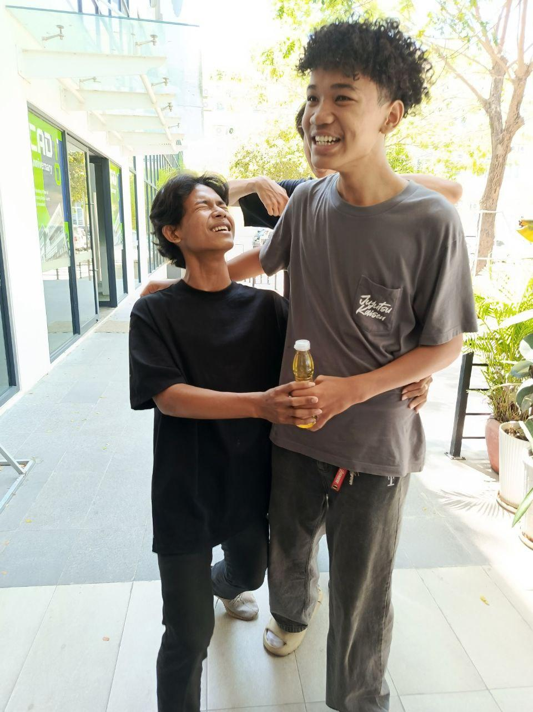
Snake Nokia
DATE
Thank you

